Slide 1
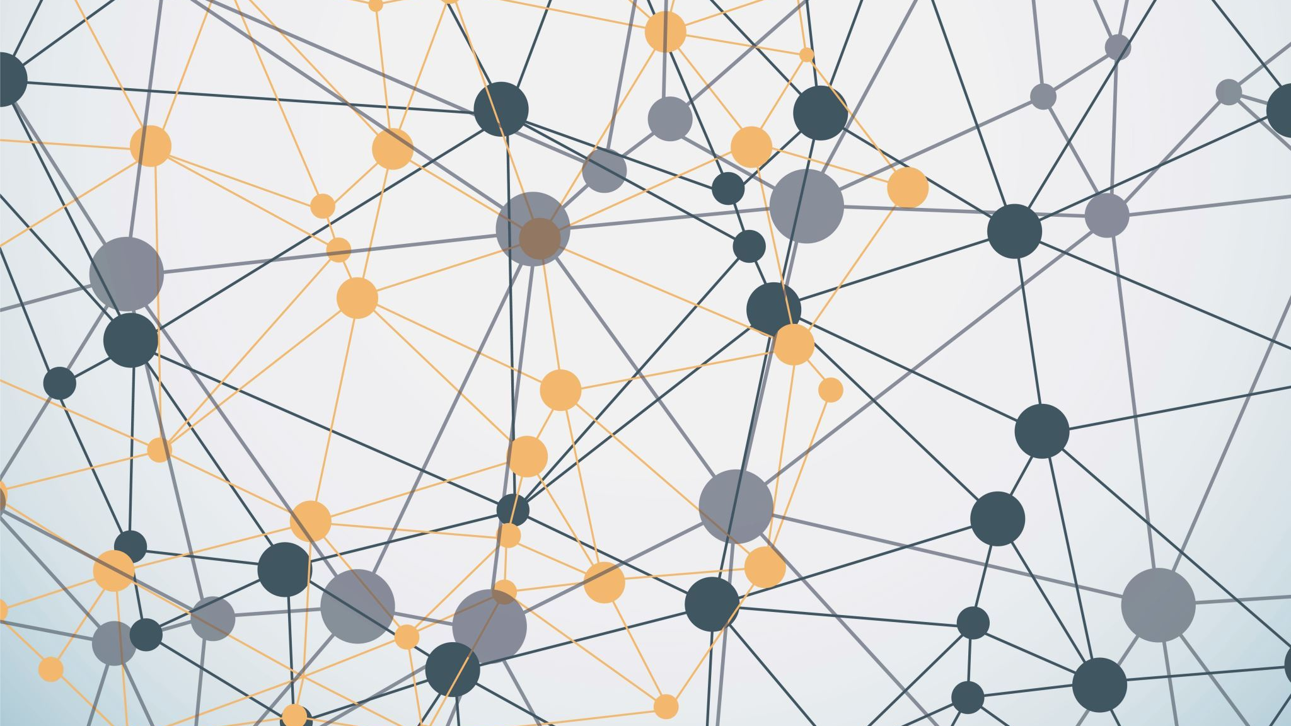
Lecture 1: Introduction to Networking
Eng / Youssef khaled
Backend Roadmap

Slide 2
What is Networking?
Networking means connecting computers and devices to share information.
It allows devices to talk to each other.
Example: Connecting your phone to Wi-Fi to access the internet.

Slide 3
Why is Networking Important?
Networking helps us share files, access the internet, and communicate.
Examples of uses:
- Email: Sending and receiving messages.
- Web browsing: Accessing websites.
- Social media: Connecting with others online.

Slide 4
What is the Internet?
The internet is a global network of computers.
It connects millions of devices worldwide.
Example: When you visit a website, you are connecting to another computer.

Slide 5
IP Addresses
An IP address is a unique number given to each device on the network.
It’s like the home address for your device on the internet.
Example: 192.168.1.1 is an example of an IP address.

Slide 6
Types of Networks
- LAN (Local Area Network):
Small, local network (e.g., in your home or office).
- WAN (Wide Area Network):
Large network covering cities or countries (e.g., the internet).

Slide 7
How Data Travels in Networks
Data is broken into small pieces called packets.
Packets travel from one device to another through cables, Wi-Fi, or satellites.
They are reassembled when they reach their destination.

Slide 8
What is a Server?
A server is a computer that provides services to other devices (called clients).
Example: When you visit a website, your browser connects to a server.

Slide 9
What is a Router?
A router is a device that directs data from one network to another.
It helps connect devices in your home to the internet.
Example: Your home Wi-Fi router.

Slide 10
Network Security Basics
- Firewalls: Block unwanted traffic to protect your network.
- Encryption: Scrambles data so only the intended receiver can read it.

Slide 11
Summary
- Networking connects devices for communication.
- The internet is a global network that connects millions of devices.
- Devices use IP addresses to communicate.
- Routers and servers help move data across networks.

